Slide 1
Te Ara Whakapiri: Principles and guidance for THTP Students in Hospice work
Marion Titmuss THTP Director
BA Hons ALCM CHM

Slide 2

Session format
The Liverpool Care Pathway for the Dying person
Background to Te Ara Whakapiri
The Toolkit (April 2017)
Quick tour of some of the contents
Implementation
Recognising dying and getting started
2

Slide 3
THTP Students
All THTP students are required to undertake Hospice training, this may be a one day or several day course depending on the provider in your area.
I have included this powerpoint for THTP students to enable you to have relevant and up to date information regarding Hospice frameworks and models from a UK/NZ perspective.
I trust you will compare and add this to your knowledge base gained from the training you receive in your own country.

Slide 4
The Liverpool Care Pathway
LCP was an integrated pathway developed in the UK, aimed to transfer best practice approaches used in hospices to other settings in relation to the care of people who are dying
The LCP was introduced in New Zealand in 2006 and implemented across > 350 health care services (NZ version)
4

Slide 5
Is there a problem?
Extensive literature to show that end of life care is often managed badly
Linked with a lack of training and a lack of organisational priority
Problems arise specially if the person is not identified explicitly as dying and particularly around family and spiritual care
Poor care impacts negatively on patients, families and staff
You only die once, so we have one chance to get it right
5

Slide 6
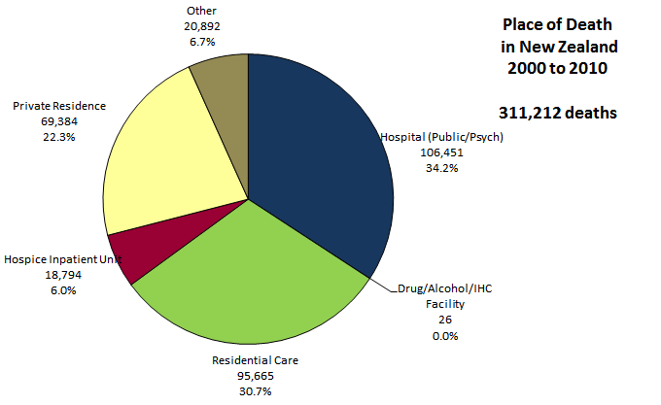
Place of Death 2000-2010
For deaths > 85 yrs, 54.8% in ARC,
only 9.9% in private residence
6
Source: Analysis of Ministry of Health MORT data 2000 to 2010

Slide 7
Last days of life working group
Established April 2014
  Independent Review in UK analysed to assess relevance to NZ models of care, including the Liverpool Care Pathway
  Stocktake of services
  Literature review of evidence and best practice
  Survey of family / whānau to understand the consumer perspective on the care of people in their last days of life
7

Slide 8
Survey findings
Barriers to communication (hospital);
“I did not know what ‘palliative care’ meant at the time. A doctor told me “we are offering palliative care now”. I thought it was a different type of medicine they were offering to make my Uncle well again, so it was a huge shock when he died.”
8

Slide 9
Place of death
“It was important for our mum to be surrounded by her whānau and mokopuna. But at the same time she didn't want to be a burden. She had been in and out of hospital but grieved for the sounds of her mokopuna playing in the background which for her gave her a sense of belonging and normality even though she was very unwell. Further, the whānau needed time to prepare for a pending death. this time with our mum sort of enabled that. She was also able to have access to constant karakia, waiata, and laughter. laughter is very healing for the spirit.” (home)
9

Slide 10
Experience after death
“When I saw him after he died I was amazed by the peacefulness and how the rest home staff had cared for him. This was a huge help to me. I felt that he was my dad again. I did not expect this to be the case and this will be my lasting impression. I am very grateful for this.” (aged residential care)
10

Slide 11
Issues identified across all settings
Poor communication with the person, family/whanau
Delays in access to care and support after hours especially in aged residential care and primary care settings
Instances of a lack of caring, compassion and respect in the hours/days before death e.g. poor pain control
Not recognising the dying patient
Support after death
Some families/whanau not well supported especially after sudden/unexpected deaths
Delays in the release of the deceased
from hospital
Lack of access to bereavement support and information
Lack of information for carers of what happens after death, especially post mortems and coronial processes
Family/whanau not always prepared for the final moments
11
Notes:
NOT RECOGNISING THE DYING PATIENT
POOR COMMUNICATION
FAMILY WHANAU NOT ALWAYS PREPARED
INSTANCES OF LACK OF COMPASSION AND RESPECT
LACK OF INFORMATION
DELAYS IN ACCESS TO CARE AND SUPPORT AFTER HOURS
LACK OF ACCESS TO BEREAVEMENT SUPPORT AND INFORMATION
SUPPORT AFTER DEATH ESP SUDDEN DEATHS
DELAYS IN THE RELEASE OF THE DECEASED FROM HOSPITAL

Slide 12
Te Ara Whakapiri
- the path to closeness/unity
(the unifying path)
Published December 2015
12

Slide 13
Te Ara Whakapiri focuses care on what matters most
Provision of person-centred and dignified care
Clear and compassionate communication
Attention to cultural and spiritual needs
Attention to detail on symptom management
Supporting the family/whānau
Care after death
13

Slide 14
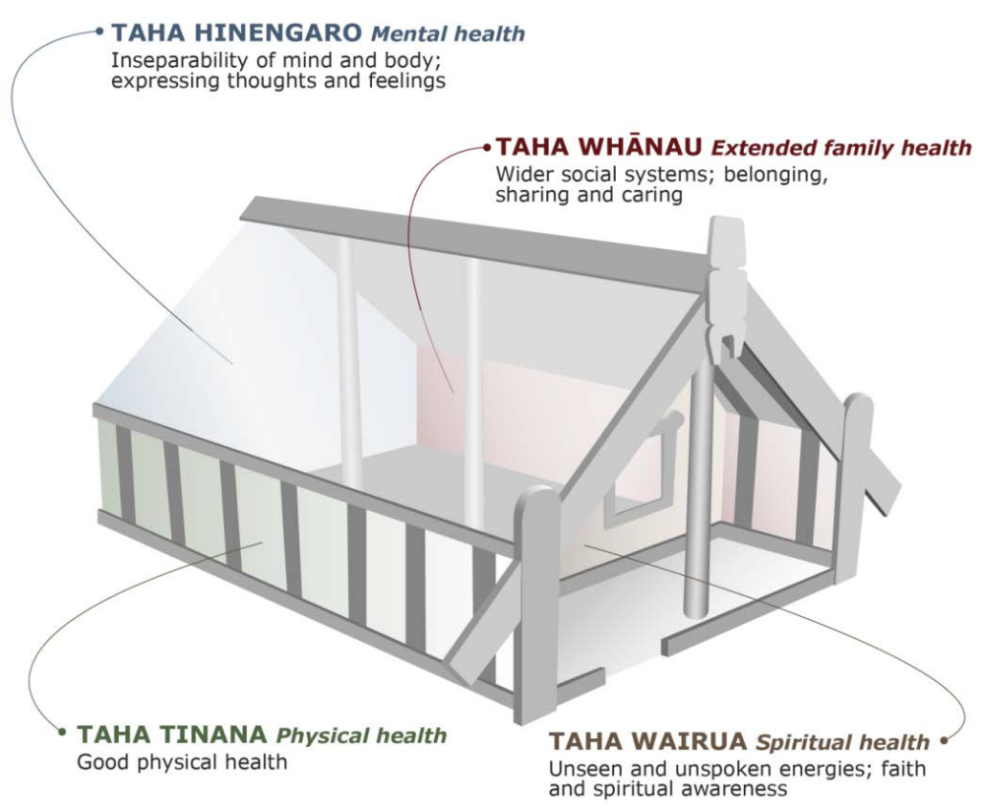
Te Whare Tapa Whā model of care supports the principles of care (Durie 1985)
14

Slide 15
3 components to care
A comprehensive baseline assessment involves identifying the lead practitioner, assessing clinical needs, sensitive and open communication, and clear documentation.
Ongoing assessment emphasises the importance of developing individualised care plans.
After death care includes verification of death and the need of the family/whānau for information and privacy.
15

Slide 16
Each of these is addressed from the perspectives of;
the person who is dying and their family/whānau
the health professional(s) providing care
the specific clinical service or health care organisation (primary palliative care provider and/or specialist palliative care service)
the wider health system
16

Slide 17
Development of The Toolkit
Working group re-convened with extended membership and 4 subgroups
  Initial (baseline) assessment
  Symptom management guidelines and flowcharts
  “Observation” chart
  Care after death documentation
Concise, readable and true to the NZ environment
Applicable across all health care settings
Appropriate for the non-specialist workforce to initiate and use
17

Slide 18
The toolkit
Fixed (apart from local logo)
Localisable
Care in the last days of life - Baseline assessment and care after death (4 pages)
Ongoing care of dying person - 2 page “observation chart”
Home care in the last days of life - 2 page “observation chart”
Recognising the dying person flowchart
Medical management planning -general principles
Staff signature sheet
Bereavement risk assessment tool
Discharge checklist
Symptom management guidelines (incorporating symptom flowcharts)
When death approaches (family/whānau pamphlet)
Dying at home (family/whānau pamphlet)
18

Slide 19
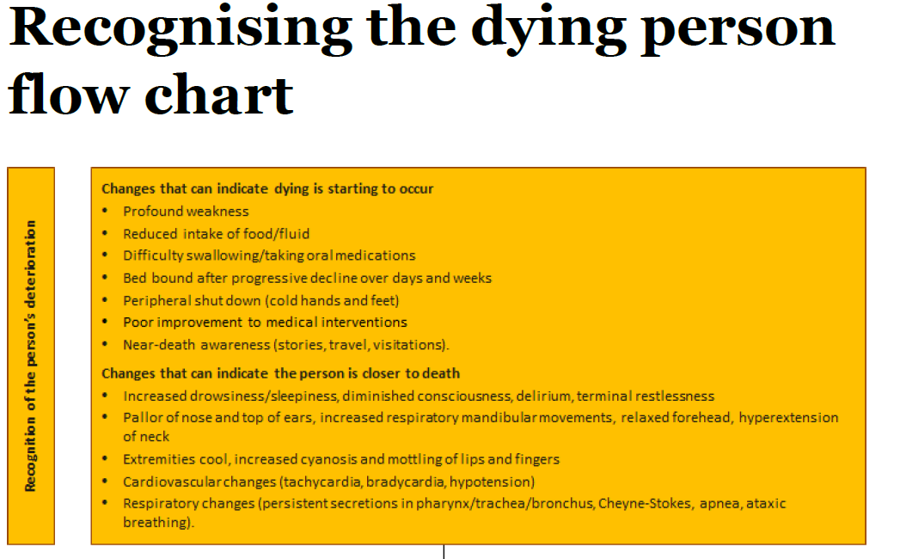
About getting everyone on the same page…
..often the biggest challenge
19

Slide 20
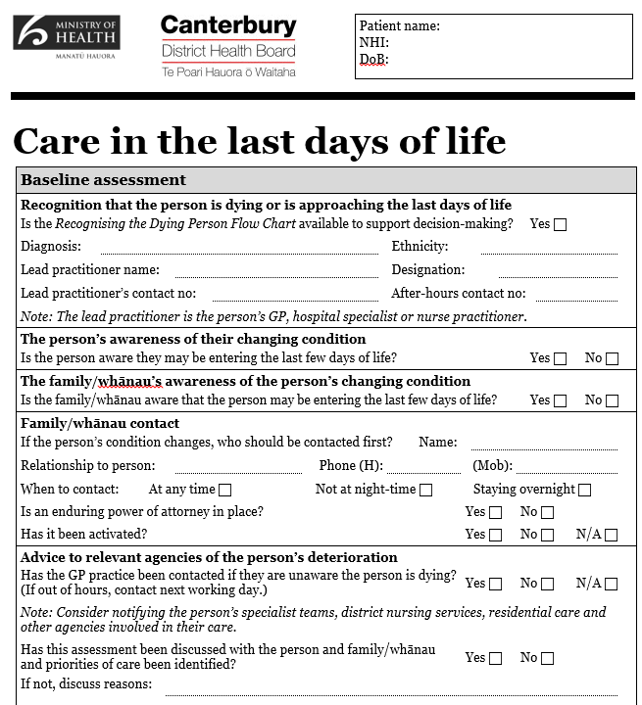
Baseline assessment & section on care after death
Completed together by nursing & medical staff
Covers physical health PLUS psychological, spiritual & family health
20

Slide 21
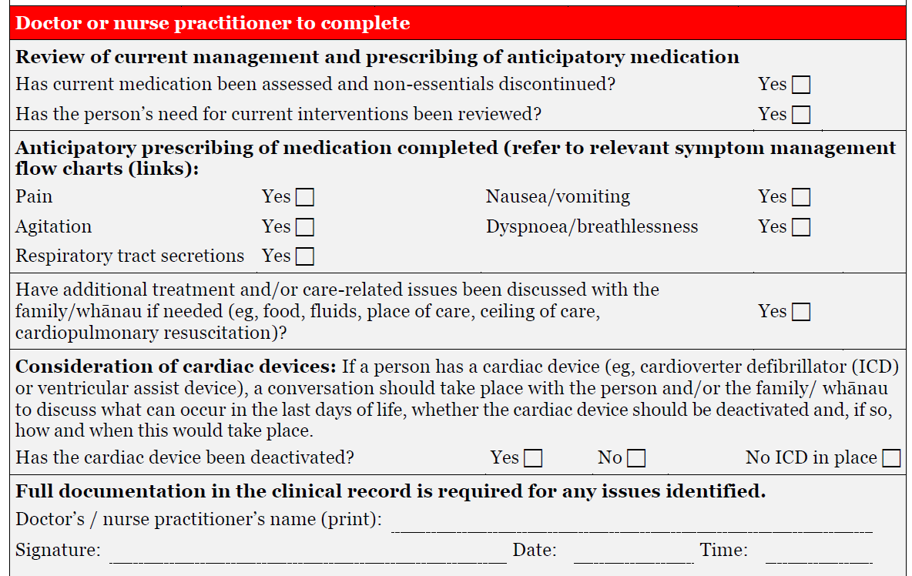
21

Slide 22
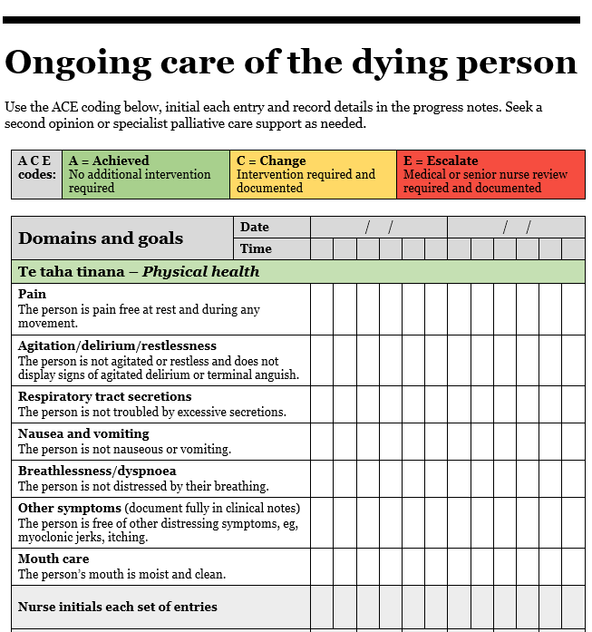
Replaces the assessment/obs chart (double-sided)
Physical, psychological, spiritual & family health
4hrly review of symptoms, others reviewed once/shift
ACE codes show priority
A = Green (achieved/absent)
C = Orange (a change has been required but issue is under control)
E = Red (escalate – needs medical review or a change in plan)
22

Slide 23
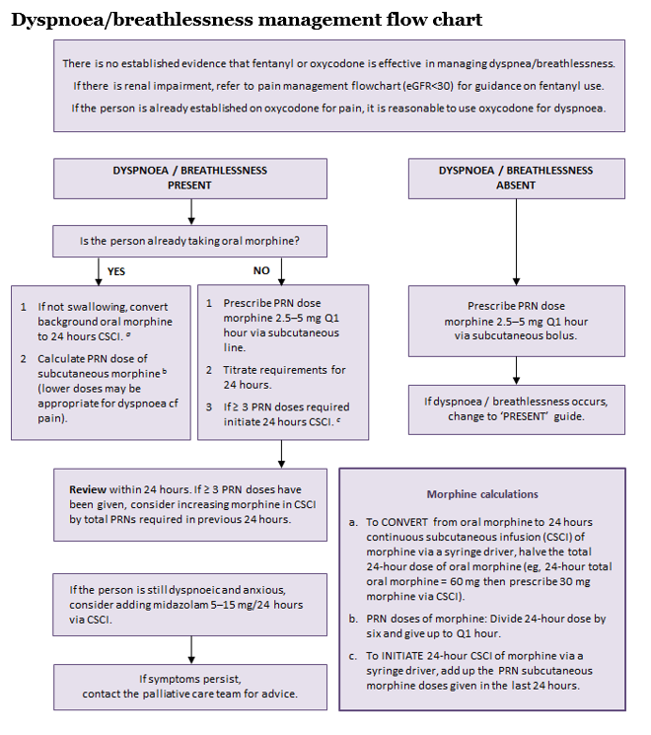
5 symptom flowcharts
1a. Pain
1b. Pain with severe renal impairment
2. Agitation / delirium/ restlessness
3. Nausea/vomiting
4. Excess respiratory tract secretions
5. Dyspnoea
23

Slide 24
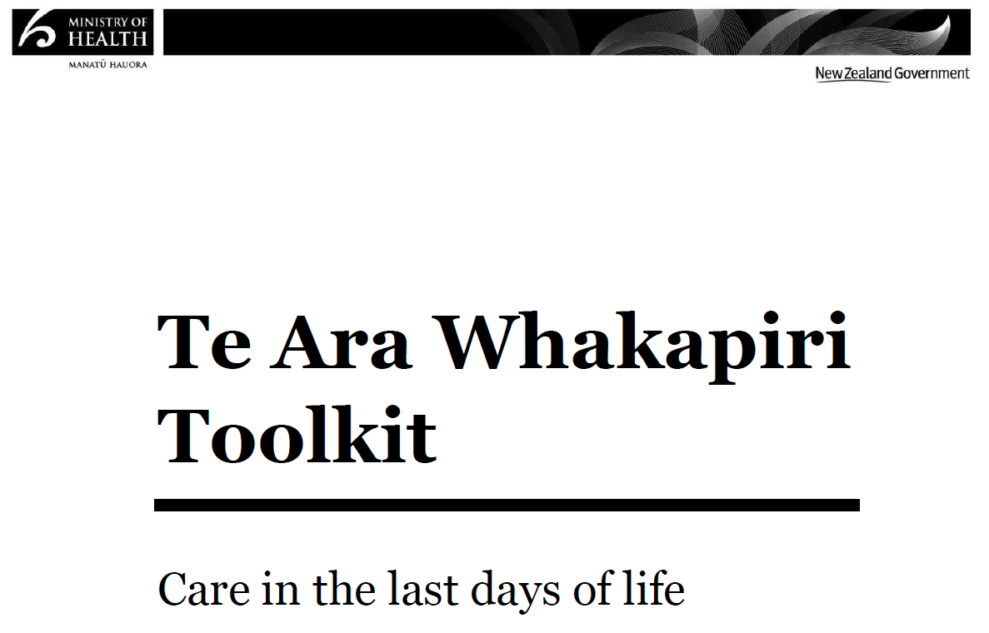
April 2017
http://www.health.govt.nz/publication/te-ara-whakapiri-principles-and-guidance-last-days-life
24

Slide 25
Power of language
Don’t shy away from “Te Ara Whakapiri”
  What does the phrase mean to you and how will you explain its purpose and its value?
    To staff
    To patients
    To whānau
  More holistic and respectful than an acronym
Think of it as a “checklist” rather than “tick-box”
25
Notes:
Positive and supportive language

Slide 26
How to get started
Be alert to the possibility your patient may be dying
Listen to junior staff/nurses/allied health, patient AND family
Make a positive decision; be clear and supportive
Complete Care in the last days of life together (nurse + doctor +/- others)
  Initiate the Ongoing care of the dying person chart
  Utilise Symptom management guidelines if needed
26

Slide 27
Potential triggers
(insert any local processes e.g. daily “Board Round” or MDT)
Ceasing routine observations
Move to a single room
“Comfort cares”
Patient or family request for withdrawal of active treatment
  “Listen to the patient, and if the patient is unable to communicate then listen to the family/carers of the patient” (survey)
27
Notes:
Pause point

Slide 28
“Diagnosing dying”
What are the benefits?
  Cease burdensome/futile treatments, tests and recordings
  Anticipatory prescribing
  Inform family/whānau so they can be present
  Privacy (single room) – a necessity for preservation of dignity
  Support for family
  Time to say goodbye
  May identify that the person wishes die at home (can utilise the Discharge checklist and the Dying at home pamphlet)
28

Slide 29
Next steps
The BIGGEST challenge is implementation, without new resources
Hospice NZ are partnering with the MOH and other leaders to promote integration and socialisation across the health sector but locally is where the real work happens
  Dying happens everywhere and quality care cannot be reliant on specialists being there all the time
  Need to find creative opportunities within existing systems
    This is about everyone having a role
29

Slide 30
“Dignity and privacy are commodities beyond value in the dying.”
unknown
30

Slide 31
This presentation has been developed by:
Dr Kate Grundy, Palliative Medicine Physician and Clinical Director, Canterbury Integrated Palliative Care Services
Helen Sawyer, Palliative Care Clinical Nurse Specialist, Southern District Health Board
Marion Titmuss, Director THTP
31

