Slide 1
THTP Aotearoa Retreat
Maori Model of Healthcare

Slide 2
Holding our life in a group

Slide 3
WAIRUA / SPIRITUALITY
is acknowledged to be the most essential requirement for health. It is believed that without a spiritual awareness an individual can be considered to be lacking in wellbeing and more prone to ill health. Wairua may also explore relationships with the environment, between people, or with heritage. The breakdown of this relationship could be seen in terms of ill health or lack of personal identity. When confronted with a problem Maori do not seek to analyse its separate components or parts but ask in what larger context it resides, incorporating ancestors or future generations to discussions. This may mean the discussion goes off on a tangent but the flow will return to the question.

Slide 4
HINENGARO / MENTAL
Thoughts, feelings and behaviour are vital to health in Te Ao Maori (the Maori world). Maori may be more impressed with unspoken signals, eye movement, bland expressions, and in some cases regard words as superfluous, even demeaning. Maori thinking can be described as being holistic. Understanding occurs less by dividing things into smaller and smaller parts. Healthy thinking for a Maori person is about relationships. The individual whose first thought is about putting themselves, their personal ambitions and their needs first, without recognising the impact that it may have on others is considered unhealthy. Communication through emotions is important and more meaningful than the exchange of words and is valued just as much, for example, if Maori show what they feel, instead of talking about their feelings, this is regarded as healthy.

Slide 5
TINANA / PHYSICAL
Is the most familiar component to all of us. For Maori the body and things associated with it are Tapu (sacred/special). There is a clear separation between sacred and common. For instance the head is regarded as tapu and Maori do not pat each other on the head, nor should food be anywhere near a persons head. When this happens it can be perceived as unhealthy. Hairbrushes should not be placed on tables nor should hats. Food is kept away from the body and so are utensils. A common thing that is observed in Maori households is that tea-towels are not placed in a washing machine but always washed by hand. Kitchen sinks/tubs should not be used to wash personal items either. When a laundry is in close proximity to the kitchen this can pose problems as well. There is also the question of personal space to take into account. Maori consider stepping over someone as rude and demeaning to that person's mana (personal authority/power). However there are different ways in which respect is shown to another person. For example Maori tend to have minimal eye contact and respect each other's space in formal situations. Body language is also an important feature to note.

Slide 6
WHANAU / FAMILY
Is the prime support system providing care, not only physically but also culturally and emotionally. For Maori, whanau is about extended relationships rather than the western nuclear family concept. Maintaining family relationships is an important part of life and caring for young and old alike is paramount. Everyone has a place and a role to fulfil within their own whanau. Families contribute to a person's wellbeing and most importantly a person's identity. A Maori viewpoint of identity of identity derives much from family characteristics. It is important to understand that a person carrying an ancestral name will often be seen as having the qualities of their namesake. It is important to be aware for Maori, a persons identity is gleaned by asking "Where are you from" rather than "What is your name?" Maori identity is based upon an ancestral Waka (canoe) a physical landmark, which is usually a Maunga (mountain), a body of water Awa (river), Moana (sea) and a significant Tupuna (ancestor). Once this is known people can share a common bond.

Slide 7
Our Whakatauki:
He aha te mea nui – he tangata, he tangata, he tangata
What is important – it is people, it is people, it is people
He aha te huarahi – I runga, I te TIKA, te PONO, me te AROHA
What is the pathway – it is
Doing what is RIGHT
with INTEGRITY
and COMPASSION

Slide 8
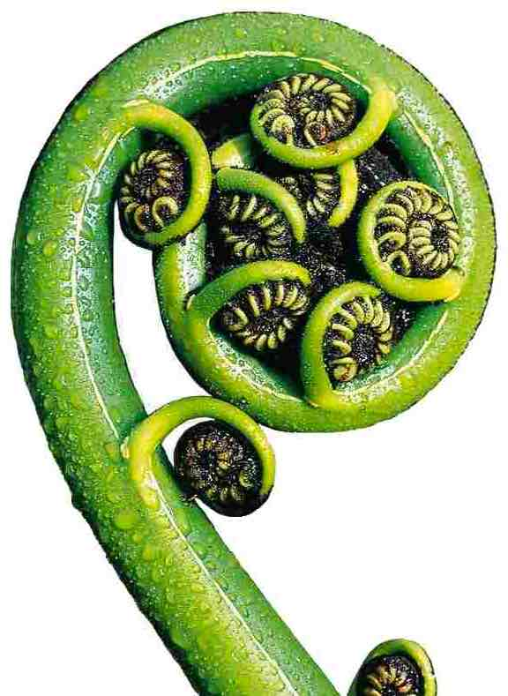
These whakatauki underpin the kaupapa Maori component of our model. The attitude of practice must reflect the spirit contained in this whakatauki, entwined throughout delivery at every level.
The restoration of Mana of people cannot take place unless the other three parts of the corner stone of Maori health are underpinned by the fourth, which is Taha Wairua (spiritual component) drawn from the Whare Tapa Wha model as articulated by Professor Mason Durie.
TAHA TINANA – Physical
TAHA HINENGARO – Mental
TAHA WHANAU - Whanau
TAHA WAIRUA – Spiritual

Slide 9
Te Puna Hauora kaupapa, tikanga and kawa are embodied in the traditional concept of whanaungatanga.
We pay tribute to Pa Henare Tate, who is the author and teacher of this inspirational concept.
Whanaungatanga encapsulates the tikanga of tapu, mana, and their expression through the principles of tika, pono and aroha.
The following explanations for tapu, mana, tika, pono and aroha, are scribed from a 1999 hui conducted by Pa Henare Tate in whanaungatanga:

Slide 10
Tapu can be broken down into three perspectives.
Firstly there is the intrinsic tapu or sacredness of being, for instance:
‘te tapu i te atua’ (the tapu/ sacredness of god/s),
‘te tapu i te tangata’ (the tapu/sacredness of people),
‘te tapu i te whenua’ (the tapu/sacredness of earth).
The underlying principle here is that all living things (birds, rocks, tress etc) have an intrinsic sacredness

Slide 11
Secondly, there is the tapu/sacredness of relationships between atua, tangata and whenua. Therefore the intrinsic sacredness of both a person and the earth must be acknowledged and respected in any relationship between them.
Many believe that the relationship between people and earth is validated through the relationship between people and god/s. A person breaching the relationship with the earth via abuse i.e. burying toxic waste, is in effect also breaching their relationship with atua as well as whenua

Slide 12
Thirdly there are tapu or sacredness as relating to tapu/restrictions. These restrictions support and enforce the intrinsic tapu and relationship tapu. An example of this kind of tapu would be ‘rahui’.
Rahui is a limit or ban on use of a particular resource which is put in place either to protect the resource or people.

Slide 13
Mana is the spiritual power that creates, produces and restores tapu. It can be expressed in a number of ways including:
Mana-whakahaere is the spiritual power and authority of people to order and determine their own lives according to tika, pono and aroha.
Mana-tuku is the spiritual power and authority of those with tapu and mana to share of themselves and their resources with others. Aroha is the principle under-pinning mana-tuku.
Manaaki is the act of sharing.
Mana is also authority, prestige, honour bestowed by atua of people upon individuals or representatives.

Slide 14
Tika can be defined as the principle concerned with the right ordering of relationships, among atua, tangata and whenua, the right response to those relationships and the right exercise of mana.
In other words the right way to do things.
Pono is the principle that seeks to reveal reality and to achieve integrity of relationships. In other words it calls for honesty and integrity in all that we do.

Slide 15
Aroha is the principle of expressing empathy, compassion and joy for others in all that we do.
Tika, pono and aroha are the principles of action by which we exercise tapu and mana. If one wants to have mana, one must first seek after tapu. To possess tapu one must exercise tika, pono, aroha.

Slide 16
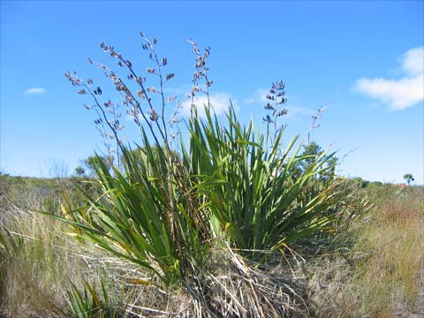
Hutia I te rito o te harakeke,
Kei hea te tauranga o te komoko e ko
Pluck or damage the centre of the flax
Where can the bellbird settle to sing
The proverb is:
Likening the flax bush to the whanau and community structure.
The centre (rito) is the child,our hope for the future.The proverb warns that if you damage or pluck the rito (child) where can the bellbird settle and sing?
The leaves next to those are the Grandparents
The outer leaves are the extended whanau and community.

